Slide 1
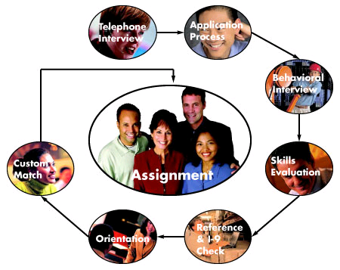
Helpful hints to land that Job!
Bruce Ullman, Human Resources, Jefferson Lab

Slide 2
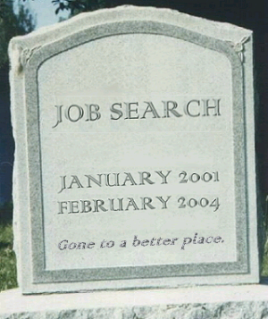
Finding a job is your job
Prepare
Research the prospective employer
Why?
Using the posting as a starting point,
Write a resume or CV
Write a cover letter
Prepare for all types of questions
Open-ended
Situational
Behavioral

Slide 3
Research the prospective employer
The more you know about them, the more they will want to know about you
Know their history, mission, values
Start at their website
Slant your resume toward things that will resonate with them
Do a Web search for recent news
Demonstrate your knowledge in your cover letter

Slide 4
resume or CV?
Resume is most effective for
Business, industry, government jobs
Some research jobs in industry/government prefer a CV
Jobs that include managerial responsibilities
Jobs where performance is measured by results
CV is appropriate for
Academic jobs
Grant, scholarship and fellowship applications

Slide 5
COVER LETTER
General
Should always accompany a resume’
No more than one page
Personal to the hiring manager, but respectful of his/her position
Standard format
Content
Introduce yourself and why you are writing—mention the job
Key purpose is to convince reader to read your resume’
Make your point(s) obvious and engaging
Focus on what will matter to your reader, not what matters to you
Show how much you know about the organization and the job
Without laying them out in detail, mention things in your resume’ that will directly relate to the particular job
Finish by saying you look forward to meeting in person, setting up an interview, hearing back, etc.

Slide 6
Sample Cover Letter
Doesn’t Andrey know this?
Information relevant to the employer and the job applied for
Personal touch
Needs a closing: “Very Respectfully,” “Sincerely,” etc.

Slide 7
Sample Cover Letter
Letterhead is nice touch
Catches hiring manager’s interest as a scientist and then brings it back to applicant’s own experience
Links skills and experience to Theory Center’s work
Makes both a professional and personal connection to the job
Keeps connection open with expectation of future contact

Slide 8
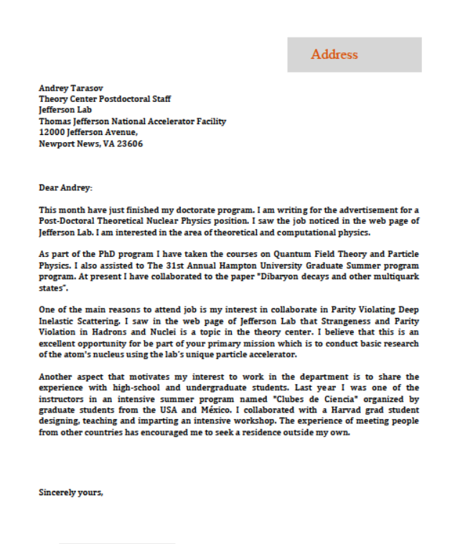
Sample Cover Letter
No date
Too informal
Poor grammar and spelling (red circles)
Demonstrates interest in program and job, shows applicant researched employer
Nice touch that may set applicant apart
Too much space; signature goes below “Sincerely yours,”

Slide 9
résumé
General
Provides a general and concise introduction to your experiences and skills as they relate to a particular career or position
Should be altered for each position for which you apply
No more than one or two pages
Should always include a cover letter
Content
Name and Contact Information: your residential address is best
Education: a listing of your degrees or certifications and educational institutions or programs
Work Experience: names of the companies or institutions you have worked for, the location of each, dates worked, your job title(s), and duties performed
Accomplishments: Products, outcomes, results for which you were at least partly responsible
Can be integrated into Work Experience
Should address issues that could translate to new job

Slide 10
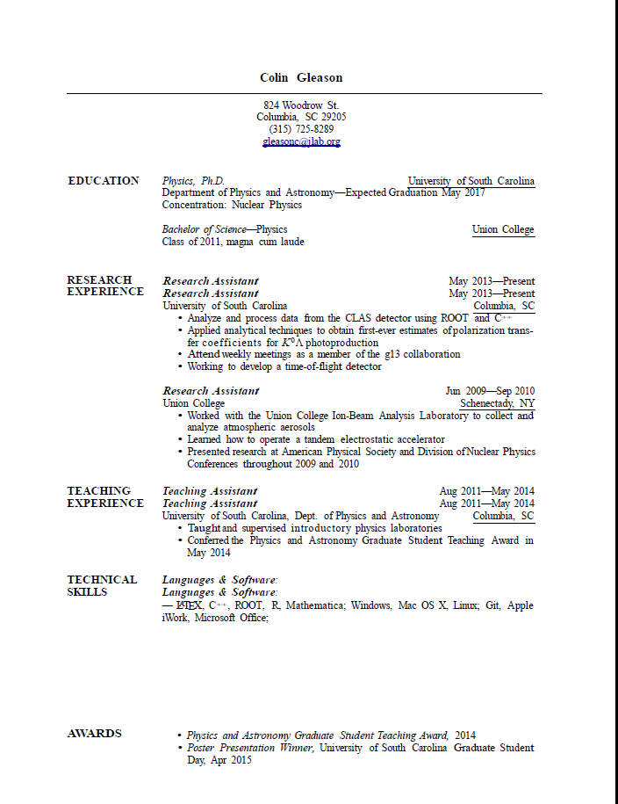
Sample Resume
Bruce L. Ullman
1987 Grunder Blvd
Newport News, VA 23606
(757) 220-2976
ullman@jlab.org
Make it easy to contact you
Work Experience can be displayed together in chronological order (most recent first), or divided into different categories relevant to the job.
Describing your responsibilities isn’t as effective as mentioning products or outcomes like these.
Accomplishments can be integrated into your work experience or listed separately. Just be careful with your words. “Conferred” means he gave the award to someone else which is obviously not the case.

Slide 11
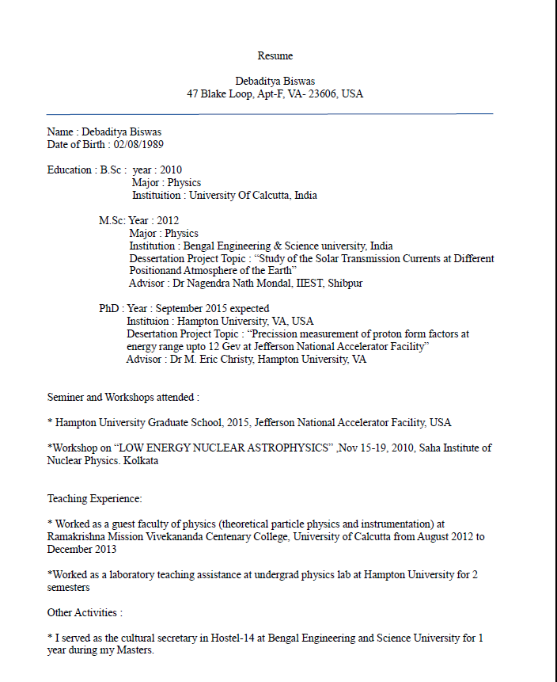
Sample Resume
Not necessary to repeat name, and age info doesn’t have to be divulged.
Misspelling and grammatical errors (like those circled) make a very bad impression; particularly in these days of spell-checkers.
Unless you received some kind of certificate at a seminar or workshop, just attending doesn’t mean much. If you learned something worthwhile, say that.
Work Experience indicates only that you put in time. What did you accomplish?
Bruce L. Ullman
1987 Grunder Blvd, Newport News, VA 23606, USA
Bruce L. Ullman

Slide 12
Sample Resume
Section takes up more room than it needs to; could be compressed into two lines
Education and experience should always start with most recent
Excellent focus on what applicant accomplished rather than description of jobs
Otherwise excellent resume’ diminished by spelling errors (circles)

Slide 13
Sample Resume
Gender, DOB, Nationality should not be included
.
Hiring Manager will not know why this is here
Education displayed in correct order, but is Project Associate an Education entry or a Work Experience entry?
Will reader know what these awards signify? If they were attained before college, they may not be considered relevant.

Slide 14
RESUME WRITING GUIDANCE
Spelling and grammatical mistakes
Competing with countless other applicants, you can’t afford to have poor grammar or spelling errors; especially if you are going to claim you are detail-oriented.
Not customizing for the job you’re applying for
Customizing your résumé for each potential job is essential. Get familiar with the job description and the company.
Over-generalizing skills and accomplishments
Specific numbers and figures give your statements weight. Similarly, in the skills section of the resume, get specific about your levels of proficiency.
Writing as a narrative
A résumé is best organized by sections and succinct bullet points. If you have very varied work experience, divide by type or shared theme and then arrange chronologically within these sections. Keep education and skills separate too.
Including every single job and school you’ve ever had or attended
Tailor your resumé for the job you are applying for and cherry-pick relevant or influential experience. If the job requires a degree, leave out education prior to college.
Ignoring or overdoing formatting
Don’t forget font choice and other aesthetic formatting, like paragraph justification and line spacing. A recent article in Bloomberg Business revealed that Times New Roman is “the typeface equivalent of wearing sweatpants to an interview.” Opt for a simple and sleek sans-serif font like Helvetica. Similarly, a résumé can give the employer a headache if the text is jam-packed. Show it to others. If they find it busy and hard to read, edit down and revise. Warning: It may be tempting to include graphics, overlays, or other interesting visuals to make your résumé stand out. Don’t. It will likely do more harm than good.

Slide 15
RESUME WRITING GUIDANCE
Forgetting to link out
If you have any other online professional presences—be it LinkedIn, a portfolio, or a blog—be sure to include a link. Warning: If you include a link, assume it will be looked at, so ensure it is entirely work appropriate and will not detract from your candidacy.
Over-exaggerating and embellishing
Every detail and fact is just a Google search away. Make sure that everything you write is indeed true. Plus, there is a fine line between confident and arrogant.
Not using action verbs
Avoid using passive phrases like "responsible for." Instead, use action verbs: "Resolved,” “Organized,” “Led,” and so on.
Not prioritizing
Capture the hiring manager’s attention right away. Include your most pertinent and applicable work experience at beginning of an entry. Don’t bury it in prose.
Mixing languages
If English is your second language, particularly if institutions, papers, etc. have non-English names, be careful to use English translations for as much as possible. Even if the hiring manager speaks your native language, someone else in the organization may see your resume’ and be put off by it.
Laying all your cards on the table
Think of your resumé as a sampling of your greatest hits—one that should intrigue interested parties enough that they’ll need to bring you in for an interview. The benefit here is that you’ll have new and exciting information to share with your interviewers.
Always write for the prospective reader (hiring manager) & focus on why you are the best fit (for that particular job)

Slide 16
CHECKLIST
Cover letter
Is my letter a resume in itself or does it just whet the reader’s appetite for more?
Did I write so my reader can relate to what I’ve said?
Was I patronizing? Too technical or abstract?
What are my reader’s language skills?
Have I included full address of recipient? Today’s date?
Is it easy to read?
Is it no more than one page?
Resume’
Is it organized in bullets and sections that are easy to navigate?
Does it have my contact information at the top?
Did I leave out things that are not relevant like age, family, personal history, grades?
Have I included relevant training or skills not tied to my degrees?
Have I focused on what I accomplished in my work experience rather than just my responsibilities?
Have others read and critiqued it from the hiring manager’s perspective?

Slide 17
summary
Finding a job requires time, energy, and dedication
Think about the “fit,” not just the “job”
Sell yourself, but don’t be over confident
One size does not fit all with cover letters and resumes
Think before you post on a social website
Be yourself!
Resources:
Science Careers from the Science Journal (http://sciencecareers.sciencemag.org/tools_tips/how_to_series)
Personal Branding Blog (packaging and promoting yourself)
Careerealism Blog (methods for job searching in today’s workforce)

